Slide 1

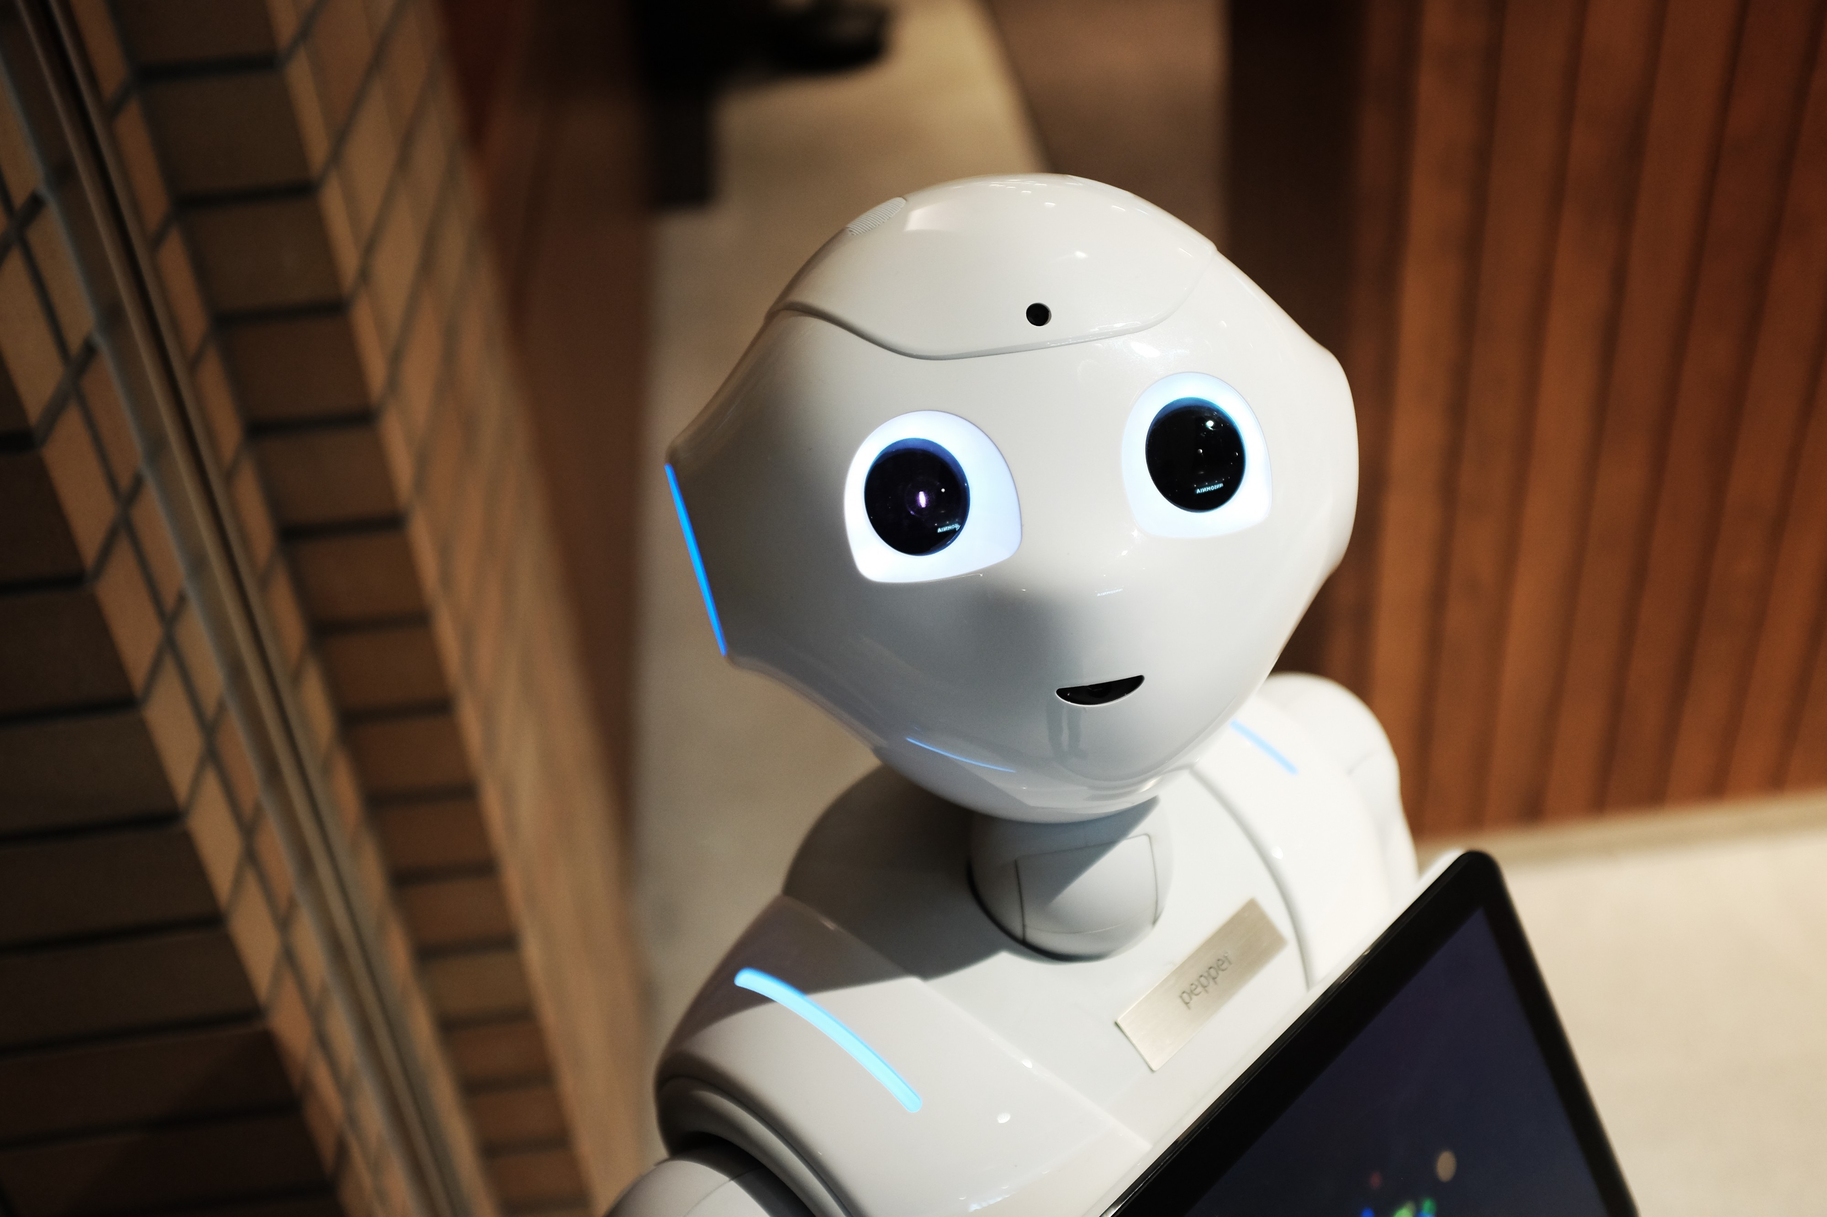
Planting Agent Technical Report
Autonomous Multiagent Systems
Course id :AI314
Instructor : Dr. Mohamed A. Wahby
Name - ID
Ahmed Kadry 20180018
Loai Gamal 20180206
Mohamed Sayed 20180224
Marina Moheb 20180208
4 MAY - Spring 2021

Slide 2
Robot's abilities
Robot's abilities
Detect if the soil suitable to be sowed by checking soil moisture and soil acidity.
Check the factors responsible for planting like temperature and light
Tells us to start planting or to fix any of the factors first.
Dig the soil then drag the seed into it.
Move a fixed distance to put another seed
Robot will use its senosrs to move the distance automatically.

Slide 3
Rationality
The robot is rational
Performance measuring success
Agent prior knowledge of environment
Actions that agent can perform
Agent percept sequence of data

Slide 4
Planning
what is our problem?
what is our main goal?
What is up coming?
the problem is in sowing the seeds.
model that sows seeds
we have global requirement in this model is to design a robot that picks and drops seeds on the soil.
Secondary requirements is :
To sense the presence of soil and Divide it into squares.
To make a hole at center of each square.
To pick seeds from the seed-container and drop it in the hole.
To develop a program to achieve and control all of these.

Slide 5
Analysis
what is the inputs?
what is the outputs?
Ultrasonic sensor
Soil moisture sensor
pH sensors
Changing light conditions
Temperature sensor
Data from input sensors

Slide 6
PEAS
Performance Measure:
Improved efficiency in planting.
Increased yielding and reliability in crop.
Increased cropping frequency.
Increased speed of seed planting.
Seed planting accuracy.
Durable and cheap as low-cost materials are used.
Less maintenance cost.
Since seed can be poured at any required depth, the plant germination is improved.
Dependency on labor also decreased. Also, it saves time of sowing.
Uniform placement of seeds in row with required distance.
Proper compaction over the seeds is provided

Slide 7
PEAS
Environment:
Farmer
Seeds
Fertile agricultural land
Temperature
Sun

Slide 8
PEAS
Actuators
Structural frame
Battery powered wheels
Seed storage tank
Seed sowing disc
Seed chamber
Plough

Slide 9
PEAS
Sensors
Ultrasonic sensor
Soil moisture sensor
pH sensors
Changing light conditions
Temperature sensor

Slide 10
Environment type
Fully observable
Deterministic certainty
Episodic
Dynamic
Discrete
Single agent

Slide 11
Agent type
What it’s type?
It is goal based agent

